Slide 1
2DEG device example
In this example, we’ll use QMT to create an example gate-defined lithographic nanowire structure, based on the paper found here.
If you haven’t done so already, please follow the instructions in read_me_first_environment_setup!

Slide 2
Part 1 : Set up the FreeCAD model

Slide 3
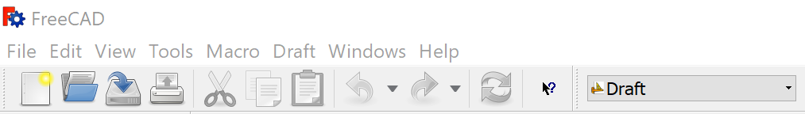
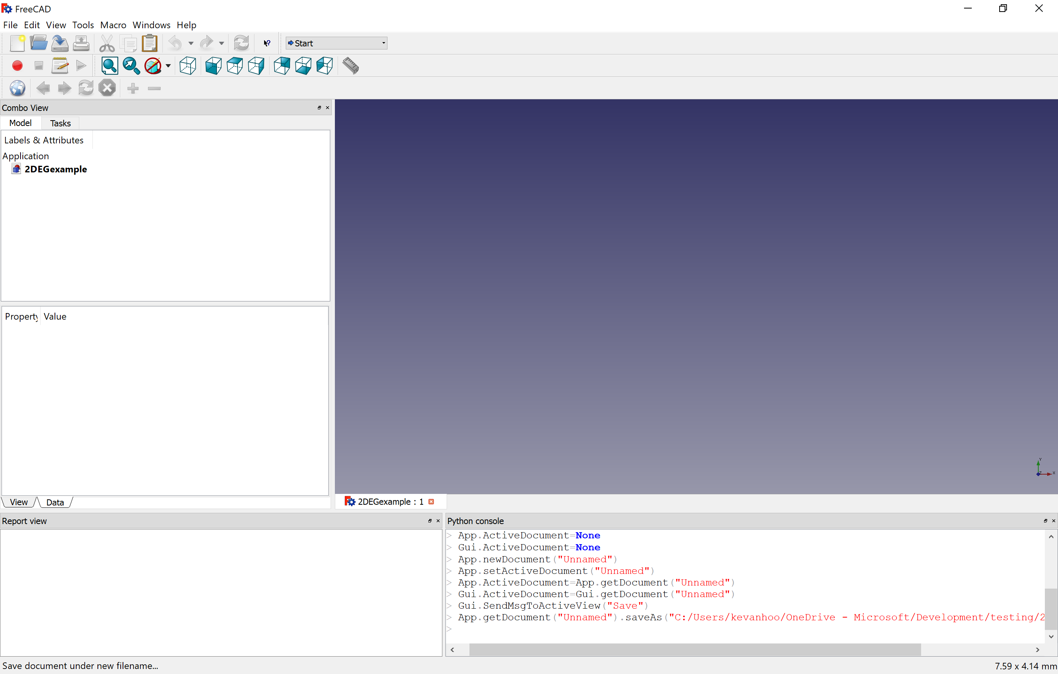
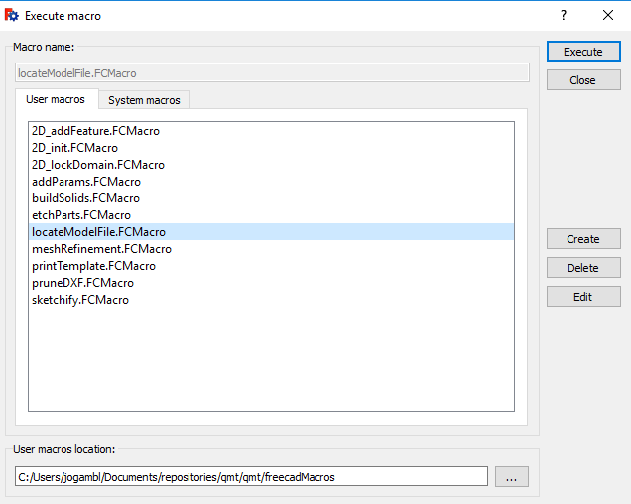
Create an empty FreeCAD model
Open FreeCAD and create a new document (ctrl-n or File/New). Save the file.
Navigate to the Draft workbench
We need to tell FreeCAD where to find the associated .json file. To do so, run the ‘LocateModelFile macro under Macro/Macros

Slide 4
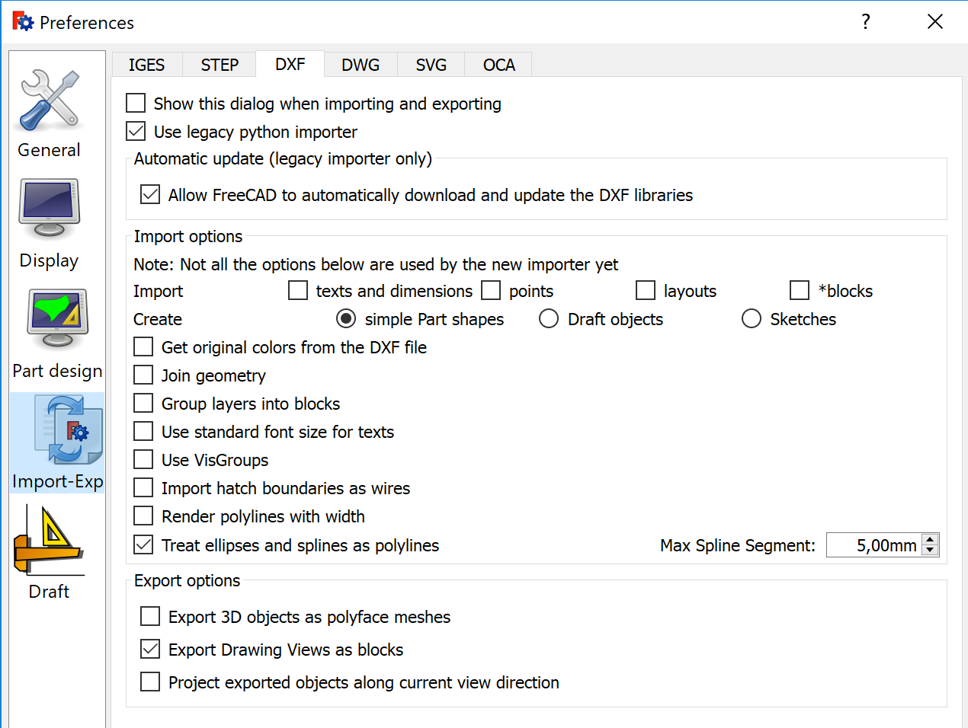
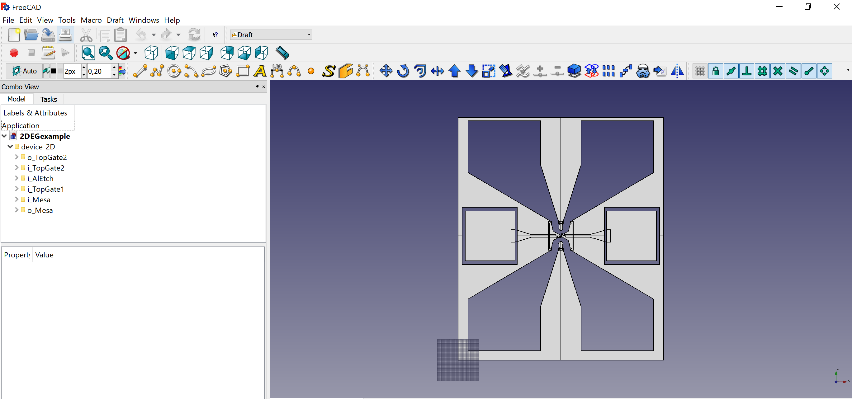
Import device_2D.dxf
First, ensure that your import setting under Edit/Preferences/Import are as shown below (left). Importantly, ‘Use legacy importer’ and ‘Allow FreeCAD to automatically download and update the DXF libraries’ should be checked.
In FreeCAD, select File/Import and browse to the device_2D.dxf file. Import the file. The result should be as shown below (right).

Slide 5
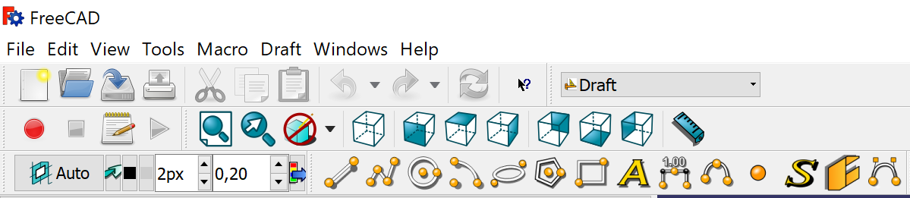
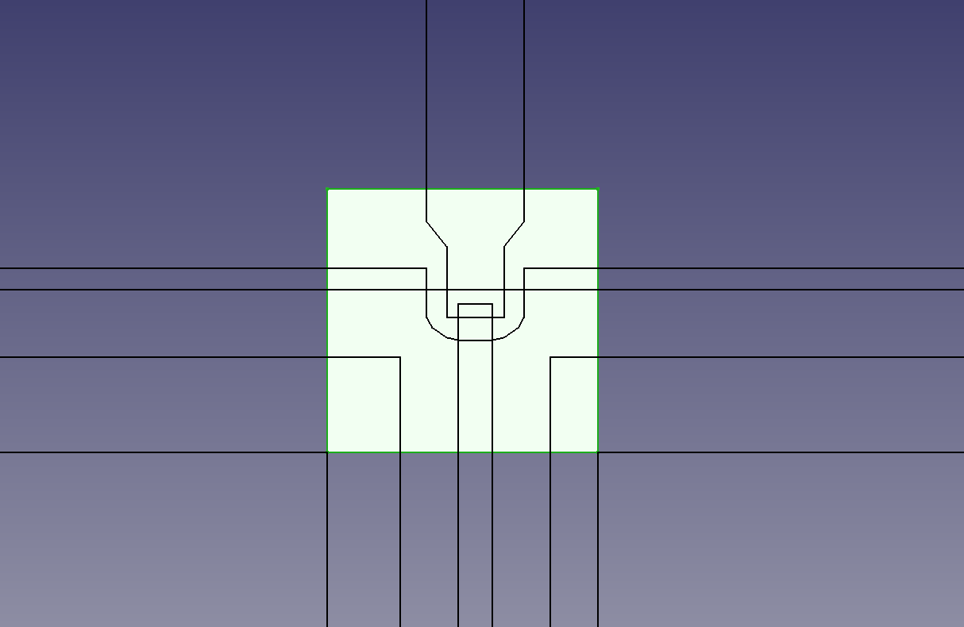
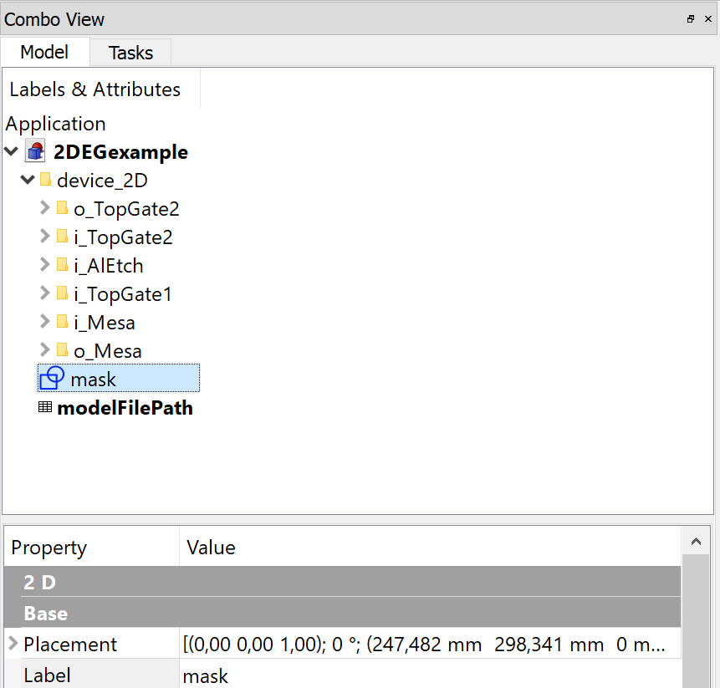
Define device region
We will now zoom in to the active region of the device (the part that we want to simulate). Most of the device needs to be excluded, as it is used to pattern ohmic contacts and other macroscopic structure. Using the Draft workbench, draw a rectangle (left top) around the device region (right) and label it ‘mask’ (left bottom)

Slide 6
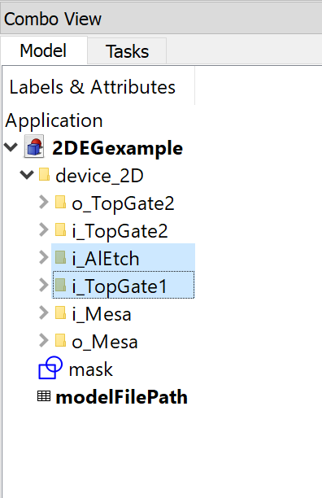
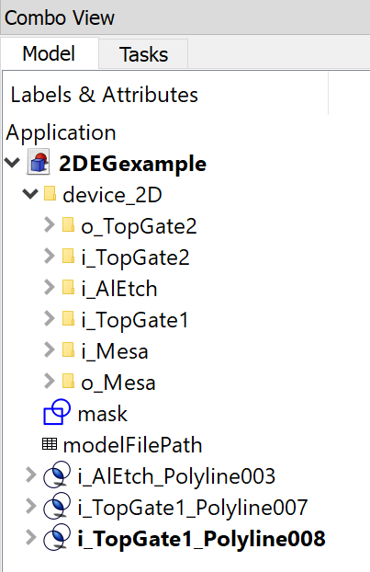
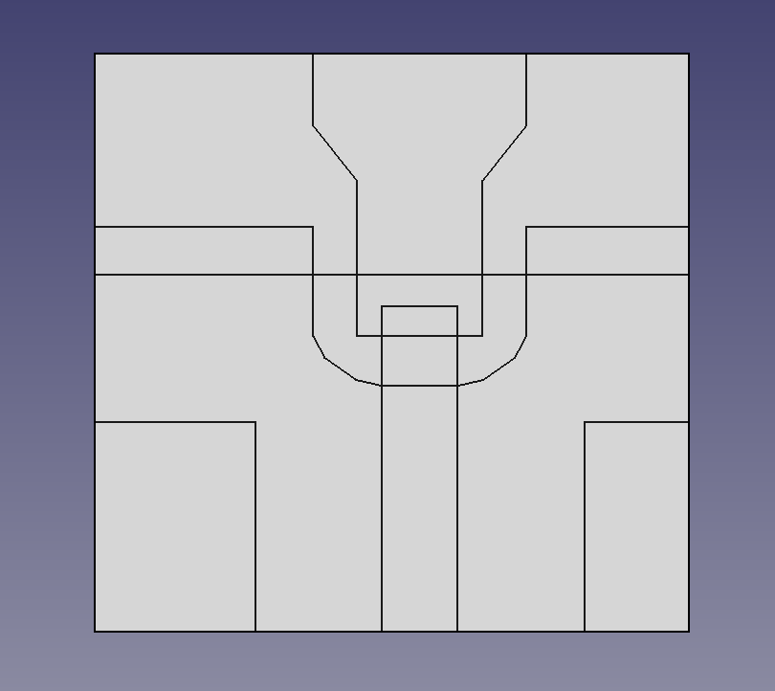
Prune dxf file
Next step is to remove the unnecessary parts of the dxf file (all regions outside the mask). In this case, only the parts i_TopGate1 (the top gate layer) i_AlEtch (the aluminum layer) contain material inside the mask. To prune, select the i_AlEtch and i_TopGAte1 in the Combo view, and run the pruneDXF macro. The 3 drafts below should be created and the simulation domain should look something like the figure below.
Before pruneDXF
After pruneDXF

Slide 7
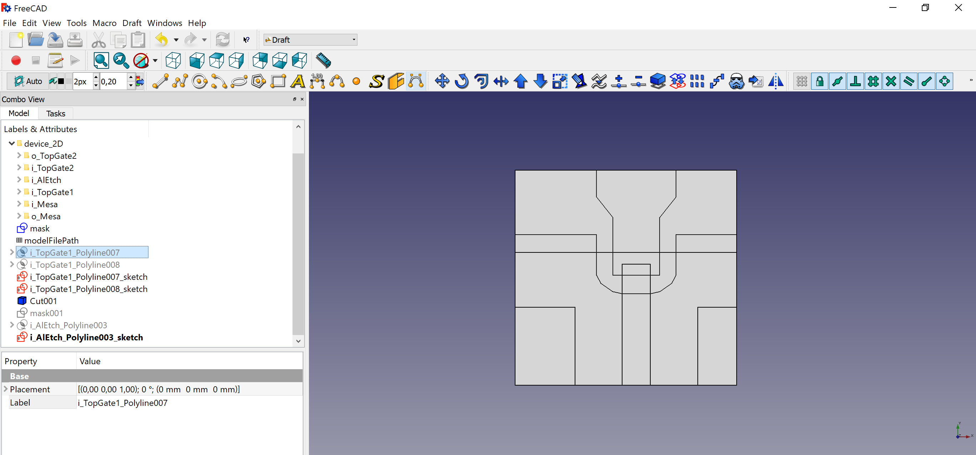
Sketchify the geometry
Next, we need to turn the file into FreeCAD sketches to facilitate a parameterized model and 3D extrusions. In addition, one of our layer specifies and etch experimentally (*i.e.*, a negative shape).
Render the positive layers as sketches by first selecting both the topGate shapes that we created in the previous step and then using the sketchify macro (you’ll have to run the macro individually for both shapes).
Select the final shape, i_AlEtch_Polyline003, run the sketchify macro, but this time check the "etch layer" box. This will invert the layer with respect to the mask:

Slide 8
Part 2 : Parametrize the geometry

Slide 9
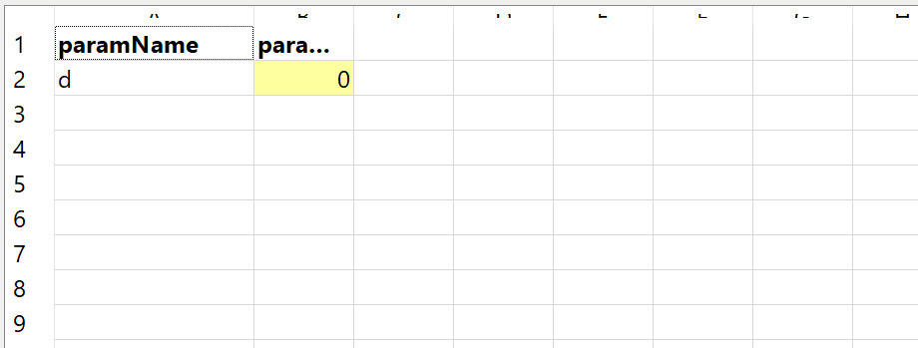
Adding a parameter
We now have the 2D information we need, we will parameterize our model. For this
tutorial, we will use the length of the top gate "finger" that serves to control the tunnel
barrier. First, we declare the single parameter we will use by using the addParams
macro. Enter one parameter, "d," for the name and 0.0 for the default value.
This creates a new spreadsheet called "modelParams" that should look like so:
Fixed
points
Length
‘d’

Slide 10
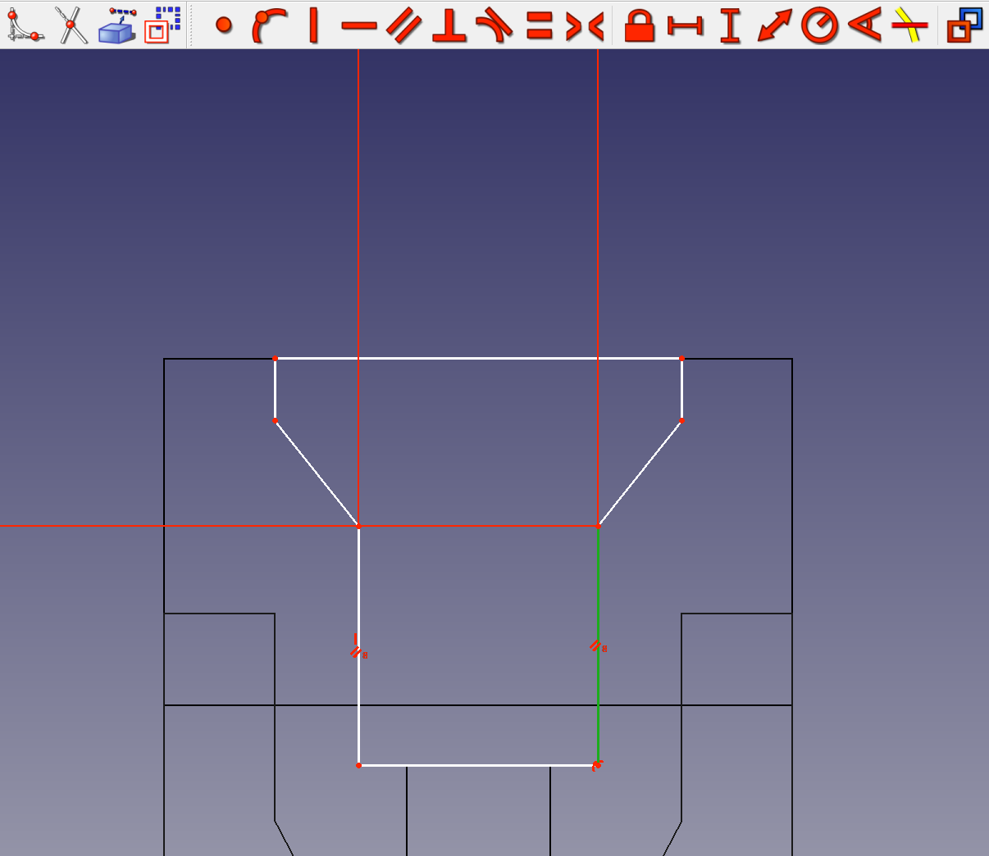
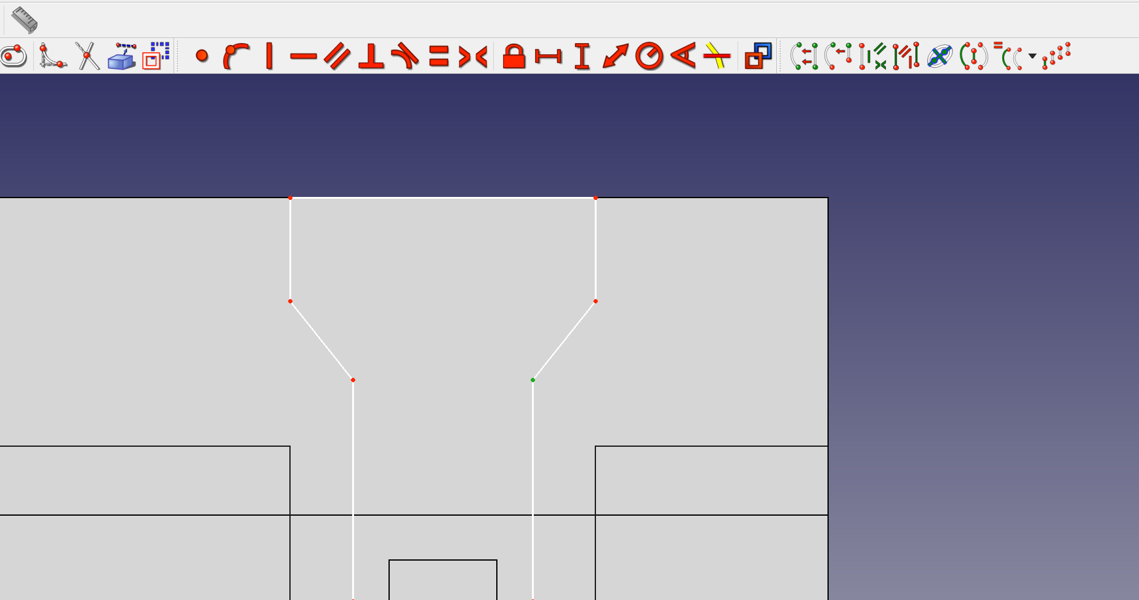
Adding lock constraints
Switch to the sketcher workbench, and edit the i_TopGate1_Polyline007 sketch
Zoom in and impose two lock constraints on the upper vertices (left figure)
Drag the center line so it coincides with the Al etch window (right figure).

Slide 11
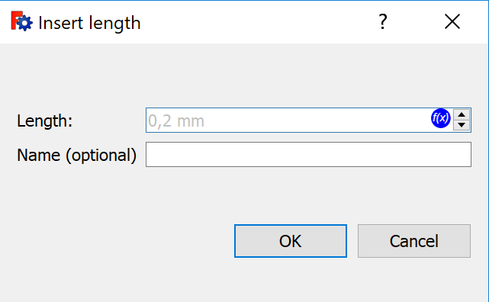
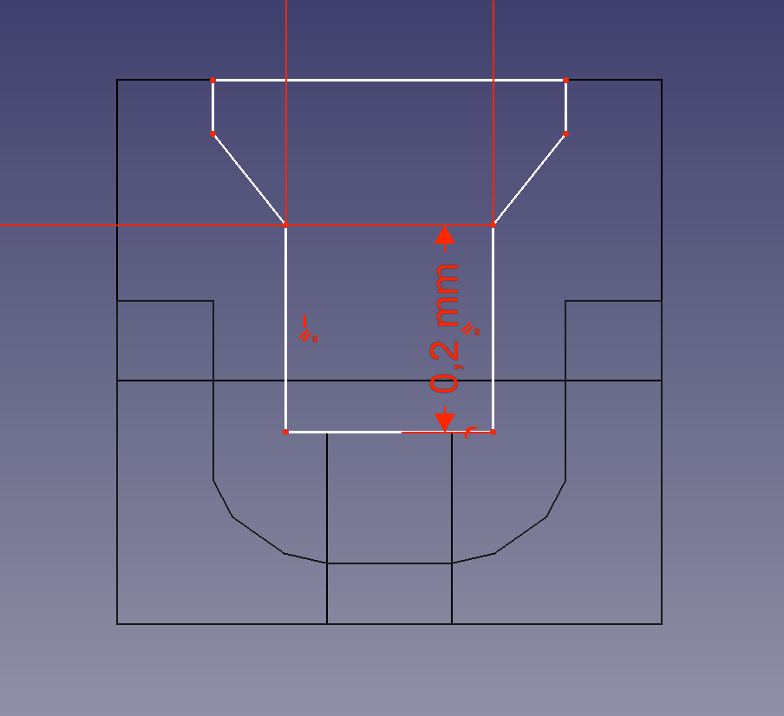
Adding a length constraint
Select on of the vertical edges on the gate
Apply a length constraint to this edge (see left figure)
Clicking the f(x) symbol in the popup screen allows one to enter an expression for the length. Enter modelParam.d + 0.2. The resulting geometry should look like the figure on the right

Slide 12
Part 3 : Creating a runfile

Slide 13
Exporting information from FreeCAD
The run is controlled by a python script, which will then import the FreeCAD model we just set up.
To generate a template, select the FreeCAD objects we’d like to reference and run the “printTemplate” macro. This will generate python code with the proper FreeCAD names that can by copy-pasted into a script.

Slide 14
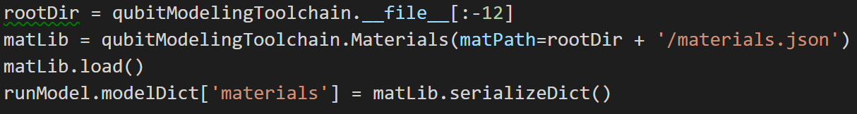
Setting the model file, file paths and materials
The first step in creating the json file is setting the following paths:
COMSOLExecPath: path to the COMSOL batch executable (comsolbatch or comsolclusterbatch under Windows)
COMSOLCompilePath: path to the COMSOL compiler (comsolcompile under Windows)
mpiPath: Command to execute MPI
pythonPath: Folder containing the python.exe that we will use
jdkPath: Folder containing JDK 1.8.0.144
freeCADPath: Path to the FreeCAD file that we created in the previous parts of this tutorial
rootPath: Folder containing the FreeCAD file
Next, we will create a model file (model.json) that contains all information on the geometry, physics, jobs of the device we are modeling
Finally, we need to make the material library available to our model file. Typically, no changes have to be made here:

Slide 15
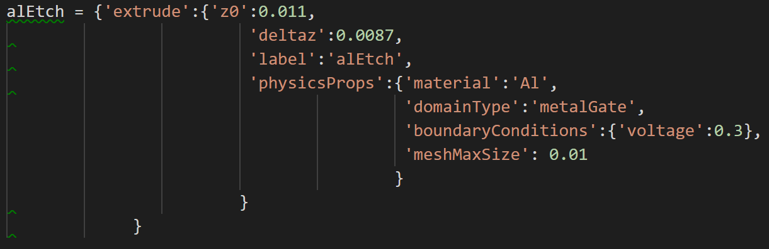
Extruding objects
In FreeCAD, we have defined a 2D structure. To create a 3D structure, we will first extrude all individual objects. Afterwards we will extrude all bounding objects (i.e. objects that extend over the entire area of the bounding box).
In the makeRun.py file, 3 extrusion objects are defined (wireGate, tunnelGAte, and alEtch). Below alEtch is shown as an example. Here, z0 denotes the offset of the bottom of the object, deltaz its height, and label corresponds to the label that the extruded object will get in the generated FreeCAD file. Under physicsProps the different modeling properties of the domain can be added. Here, the domain is a metallic gate made from Aluminum and held at a potential of 0.3 V. The maximum size of the mesh in this domain is set to be 0.01. Later we will also see how to create dielectric, semiconducting, and floating metal objects

Slide 16
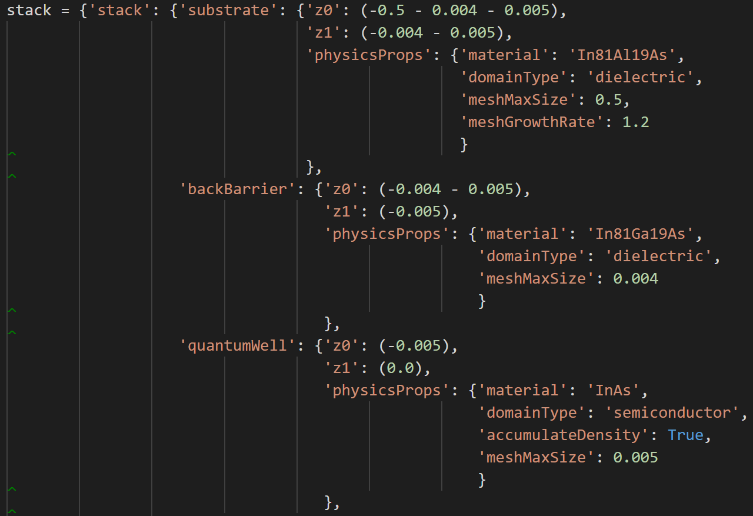
Creating a heterostructure
Besides our gates, the device we are modeling also consists of a stack of materials. From top to bottom: substrate, barrier, semiconductor, barrier, dielecric, air. This stack is defined in the stack dictionary shown on the right
This figure also shows the way to add dielectric and semiconducting domains

Slide 17
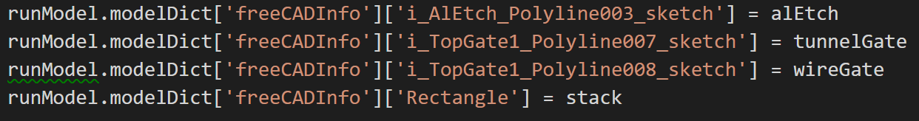
Adding extrusion information to model.json
Finally, we need to tell FreeCAD to which 2D objects the extrusions that we have just defined correspond. To do this, we store the previously-generated dictionaries in runModel.modelDict[‘freeCADInfo’][objectName], where objectName is the name (not label!) of the 2D sketch in FreeCAD to which the dictionary corresponds. To get the name of a sketch, select the sketch in FreeCAD and run the WriteFreeCADNames macro.

Slide 18
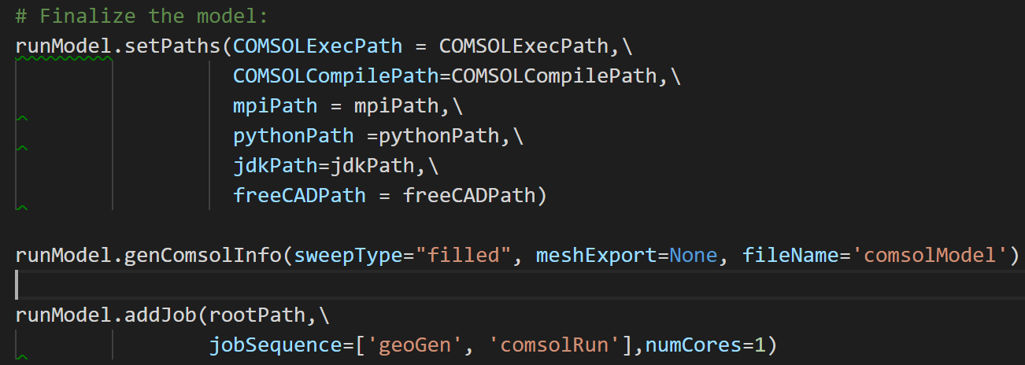
Sweeps and jobs
At this point, we have fully defined our geometry. The next step is to add sweeps. In a sweep, multiple calculations are performed for different parameters. We distinguish 2 types of sweeps: geometric sweeps (changes in geometry, not discussed here) and voltage sweeps (changes in voltage). These can be added in the following way

Slide 19
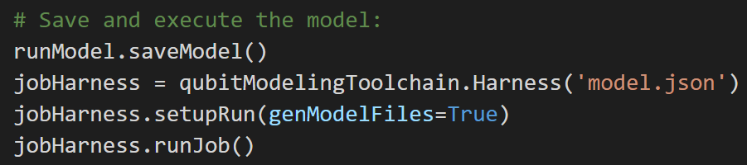
Finalizing and running the model
Now, we need to finalize the model (left figure): the paths that we defined earlier need to be added to the json file, we need to generate some minimal information for COMSOL, and we need to create a job. A job has a jobsequence consisting of ‘geoGen’ (generation of the 3D FreeCAD model, the different CAD parts, etc), and ‘comsolRun’, in which the actual analysis is carrier out.
Finally, we run the model (right figure)

Slide 20
Part 4 : Results

Slide 21
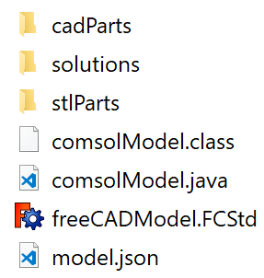
Generated files
Running the makeRun file will generate a geo_id folder, where id specifies the id of the parameter used in a geometric sweep (not used here). This folder contains
cadParts: all generated 3D objects in STEP format
solutions: solutions of all calculations
stlParts: all generated 3D objects in STEP format
comsolModel.class: compiled COMSOL model file
comsolModel.java: COMSOL model file
freeCADModel.FCStd: FreeCAD file containing the 3D geometry
model.json: the model file containing all information about the model

Slide 22
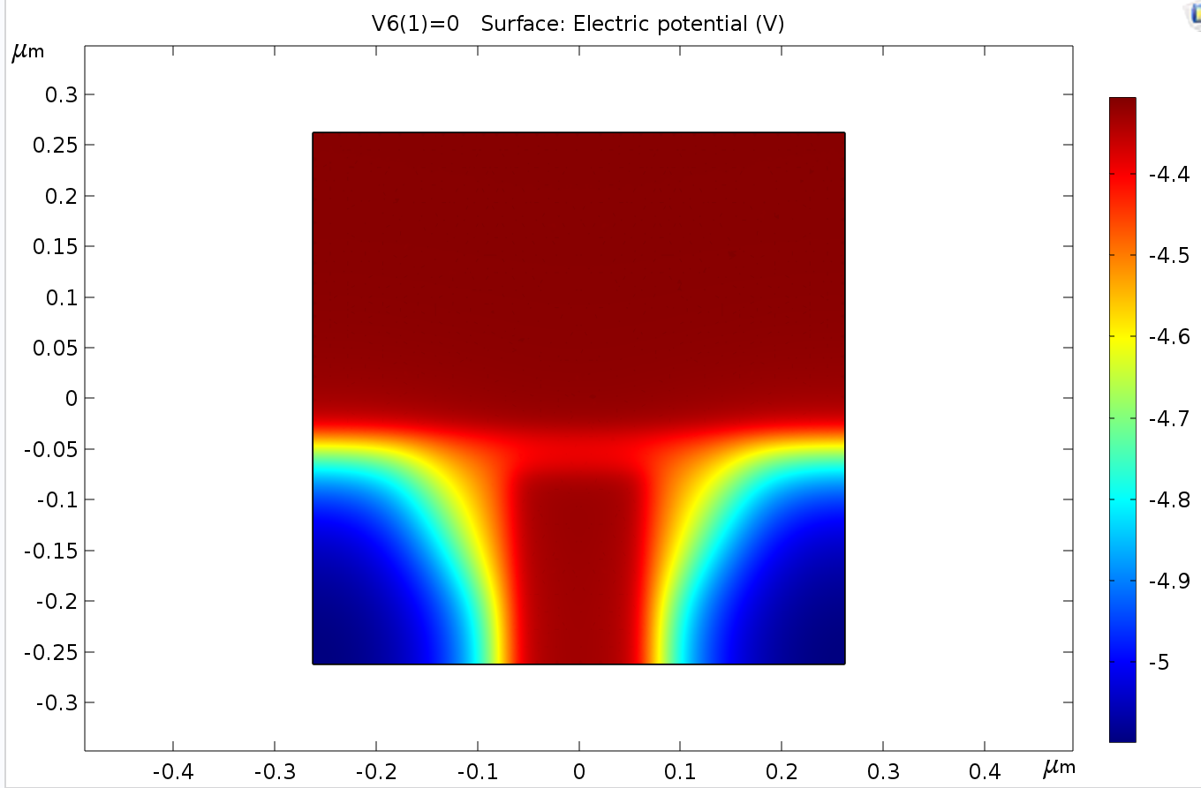
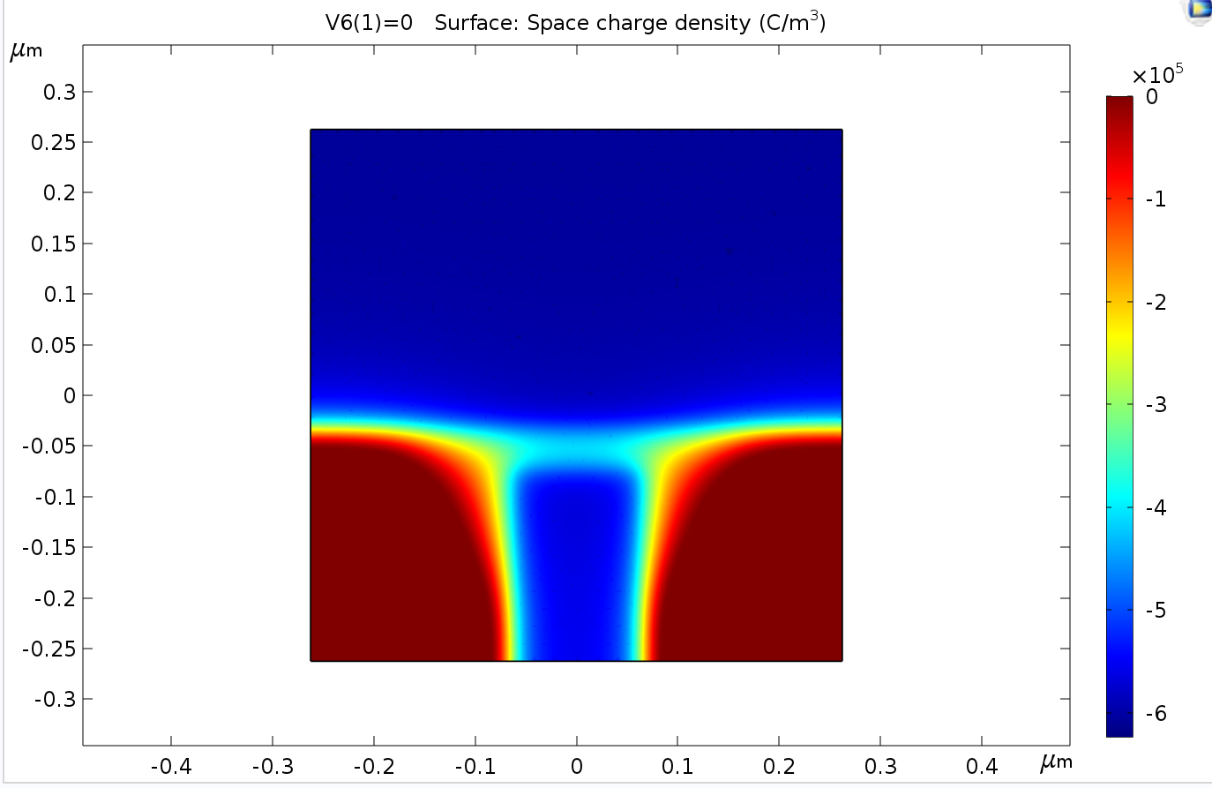
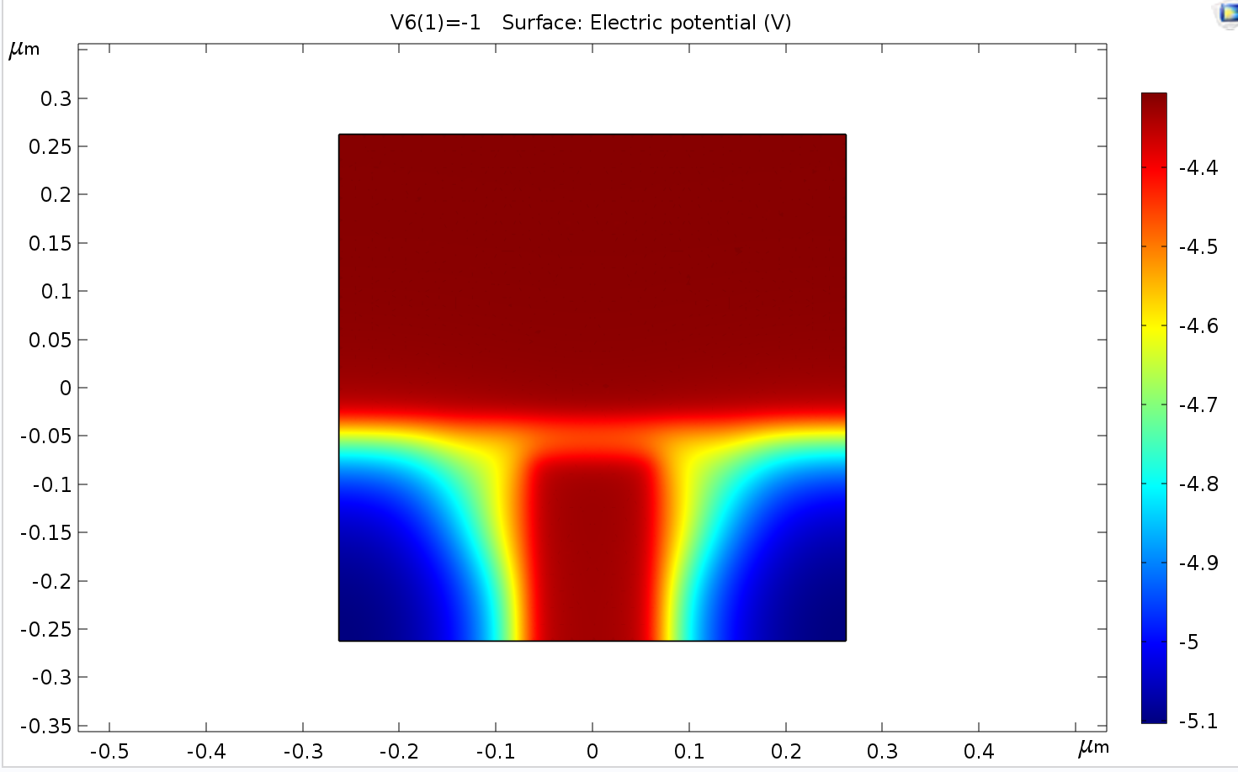
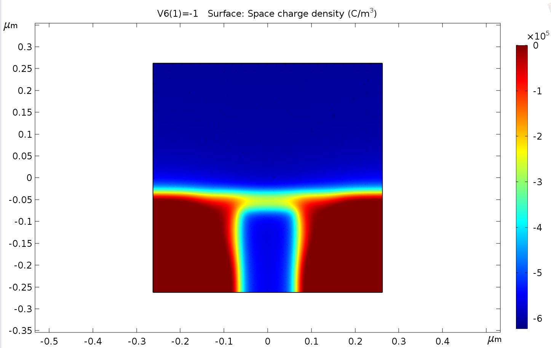
Results
Shown below is the electric potential (left) and the electron density (right) in the 2DEG for V=0V and V=-1V applied to the finger gate

